Slide 1
📘 DBMS PROJECT REPORT ON
"LIBRARY MANAGEMENT SYSTEM"

Slide 2
Submitted To: Department of Electronics and Computer Engineering [Advanced college of Engineering and Management]
Submitted By
Name: Abhishek Yadav Roll No: ACEM080BCT008 Semester: 5th semester Program: BCT
Subject:
Database Management System (DBMS)
Internal Evaluation – Practical Project
Submission Date
Falgun 17, 2082 (March 6, 2026)

Slide 3
DECLARATION: I hereby declare that this project titled “Library Management System” is my original work submitted for the Practical Internal Evaluation of DBMS. This project has not been submitted to any other institution for academic credit. Signature: ___________________ Name: _______________________ Date: ________________________
1. INTRODUCTION
The Library Management System is a database application designed to manage the operations of a library efficiently. It helps in maintaining records of members, books, authors, issued books, and staff handling the transactions.
The system reduces manual work, maintains data accuracy, and ensures proper record management using SQL queries and relational database concepts.
2. OBJECTIVES
To design a relational database with multiple entities
To establish relationships using primary and foreign keys
To implement SQL queries such as JOIN, GROUP BY, Aggregate functions
To demonstrate subqueries, views, and transactions
To ensure the database executes successfully without errors

Slide 4
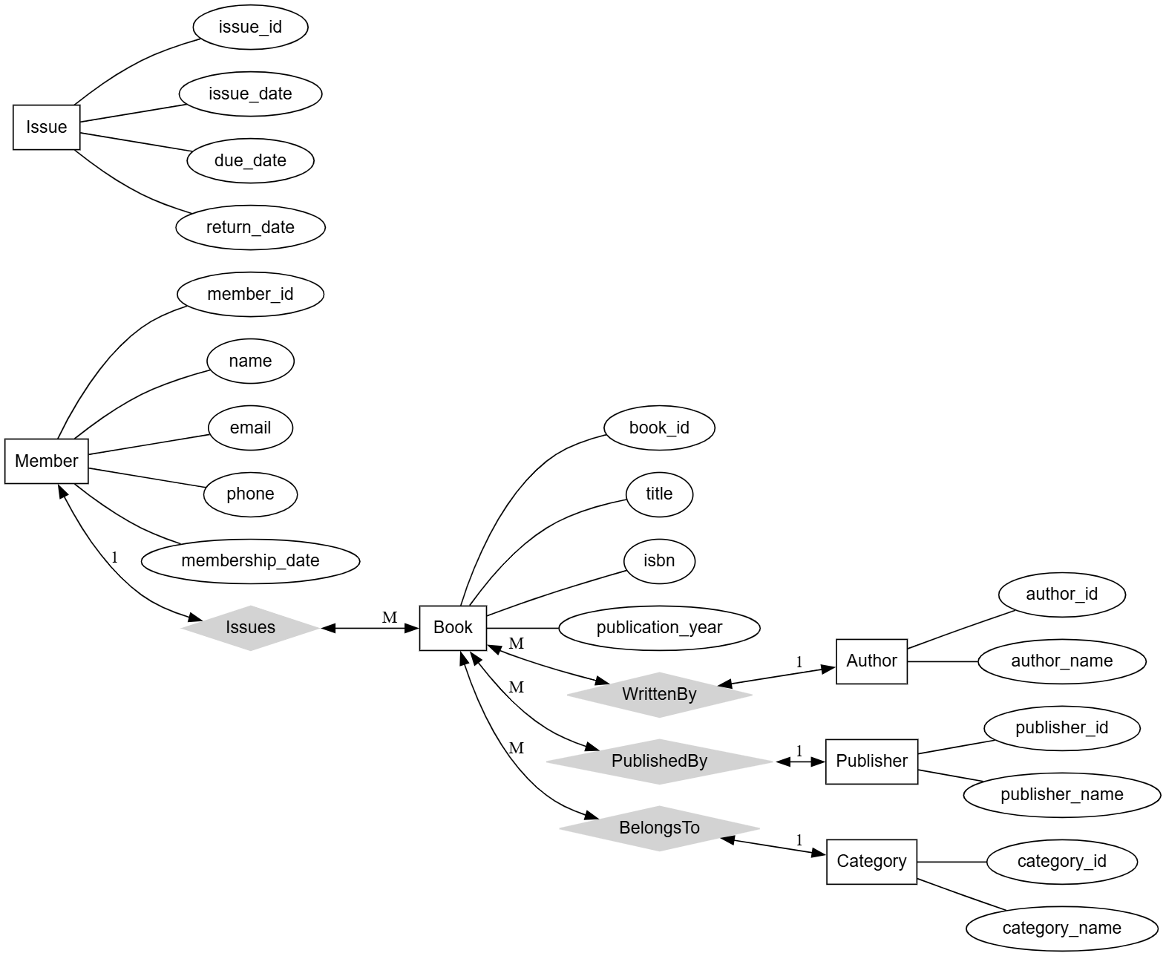
3. ENTITY LIST (Maximum 5) Member Author Book Staff Issue
4. ER DIAGRAM

Slide 5
5. DATABASE SCHEMA
MEMBER
Member-id INT PRIMARY KEY
name VARCHAR(50)
phone VARCHAR(15)
email VARCHAR(50)
AUTHOR
Author-id INT PRIMARY KEY
Author-name VARCHAR(50)
BOOK
Book-id INT PRIMARY KEY
title VARCHAR(100)
Author-id INT (Foreign Key)
price DECIMAL(8,2)
STAFF
Staff-id INT PRIMARY KEY
Staff-name VARCHAR(50)
ISSUE
Issue-id INT PRIMARY KEY
Member-id INT (Foreign Key)
Book-id INT (Foreign Key)
Staff-id INT (Foreign Key)
Issue-date DATE
Return-date DATE

Slide 6
6. SQL IMPLEMENTATION
CREATE TABLE QUERIES:
CREATE TABLE Member (
member-id INT PRIMARY KEY,
name VARCHAR(50),
phone VARCHAR(15),
email VARCHAR(50)
);
CREATE TABLE Author (
author-id INT PRIMARY KEY,
author-name VARCHAR(50)
);
CREATE TABLE Book (
book-id INT PRIMARY KEY,
title VARCHAR(100),
author-id INT,

Slide 7
price DECIMAL(8,2), FOREIGN KEY (author-id) REFERENCES Author(author-id) ); CREATE TABLE Staff ( staff-id INT PRIMARY KEY, staff-name VARCHAR(50) ); CREATE TABLE Issue ( issue-id INT PRIMARY KEY, member-id INT, book-id INT, staff-id INT, issue-date DATE, return-date DATE, FOREIGN KEY (member-id) REFERENCES Member(member-id), FOREIGN KEY (book-id) REFERENCES Book(book-id), FOREIGN KEY (staff-id) REFERENCES Staff(staff-id) );
INSERT SAMPLE DATA:
INSERT INTO Member VALUES (1,'Ram Sharma','9800000001','ram@gmail.com'), (2,'Sita Rai','9800000002','sita@gmail.com'), (3,'Hari Thapa','9800000003','hari@gmail.com'), (4,'Gita Lama','9800000004','gita@gmail.com'), (5,'Nabin Karki','9800000005','nabin@gmail.com'); INSERT INTO Author VALUES (1,'Chetan Bhagat'), (2,'Paulo Coelho'), (3,'J.K. Rowling'), (4,'Dan Brown'), (5,'Premchand'); INSERT INTO Book VALUES (1,'Half Girlfriend',1,500), (2,'Alchemist',2,450), (3,'Harry Potter',3,800), (4,'Da Vinci Code',4,750), (5,'Godan',5,600);

Slide 8
INSERT INTO Staff VALUES (1,'Admin A'), (2,'Admin B'), (3,'Admin C'), (4,'Admin D'), (5,'Admin E'); INSERT INTO Issue VALUES (1,1,1,1,'2026-01-01','2026-01-10'), (2,2,2,2,'2026-01-05','2026-01-15'), (3,3,3,3,'2026-01-07','2026-01-17'), (4,4,4,4,'2026-01-10','2026-01-20'), (5,5,5,5,'2026-01-12','2026-01-22');
INNER JOIN
SELECT Member.name, Book.title FROM Issue INNER JOIN Member ON Issue.member_id = Member.member_id INNER JOIN Book ON Issue.book_id = Book.book_id;
7. REQUIRED QUERIES:
INNER JOIN
SELECT Member.name, Book.title
FROM Issue
INNER JOIN Member ON Issue.member-id = Member.member-id
INNER JOIN Book ON Issue.book-id = Book.book-id;

Slide 9
LEFT JOIN:
SELECT Member.name, Issue.issue-date
FROM Member
LEFT JOIN Issue ON Member.member-id = Issue.member-id;
AGGREGATE (COUNT + GROUP BY):
SELECT member-id, COUNT(book-id) AS total-books FROM Issue GROUP BY member-id;
AGGREGATE (AVG):
SELECT AVG(price) AS average-price FROM Book

Slide 10
SUBQUERY:
SELECT title FROM Book WHERE price > (SELECT AVG(price) FROM Book);
VIEW:
CREATE VIEW IssueDetails AS SELECT Member.name, Book.title, Issue.issue-date FROM Issue JOIN Member ON Issue.member-id = Member.member-id JOIN Book ON Issue.book-id = Book.book-id;
TRANSACTION (COMMIT / ROLLBACK)
START TRANSACTION; INSERT INTO Member VALUES (6,'Test User','9800000006','test@gmail.com'); ROLLBACK;

Slide 11
8. CONCLUSION
The Library Management System successfully demonstrates relational database design and SQL implementation. The project includes table creation, data insertion, joins, aggregate functions, subqueries, views, and transaction control. The database executes without errors and fulfills all project requirements.

